Slide 1

Lecture 3.3 – CUDA Parallelism Model
GPU Teaching Kit
Color-to-Grayscale Image Processing Example

Slide 2
Objective
To gain deeper understanding of multi-dimensional grid kernel configurations through a real-world use case
2

Slide 3
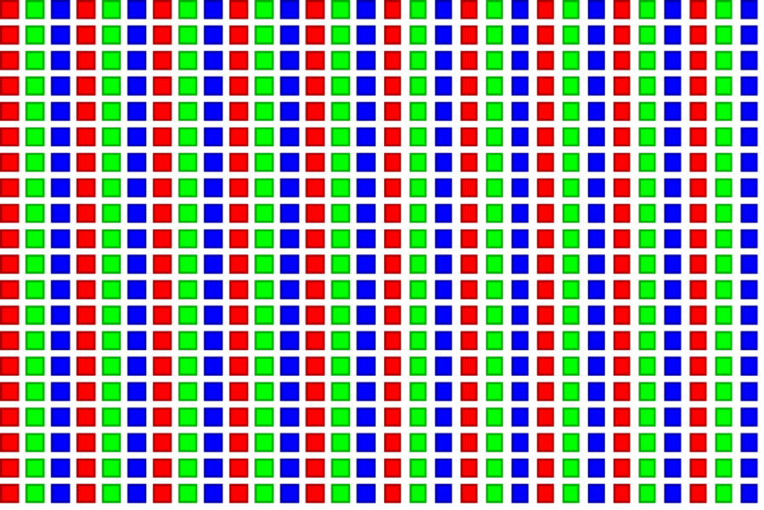
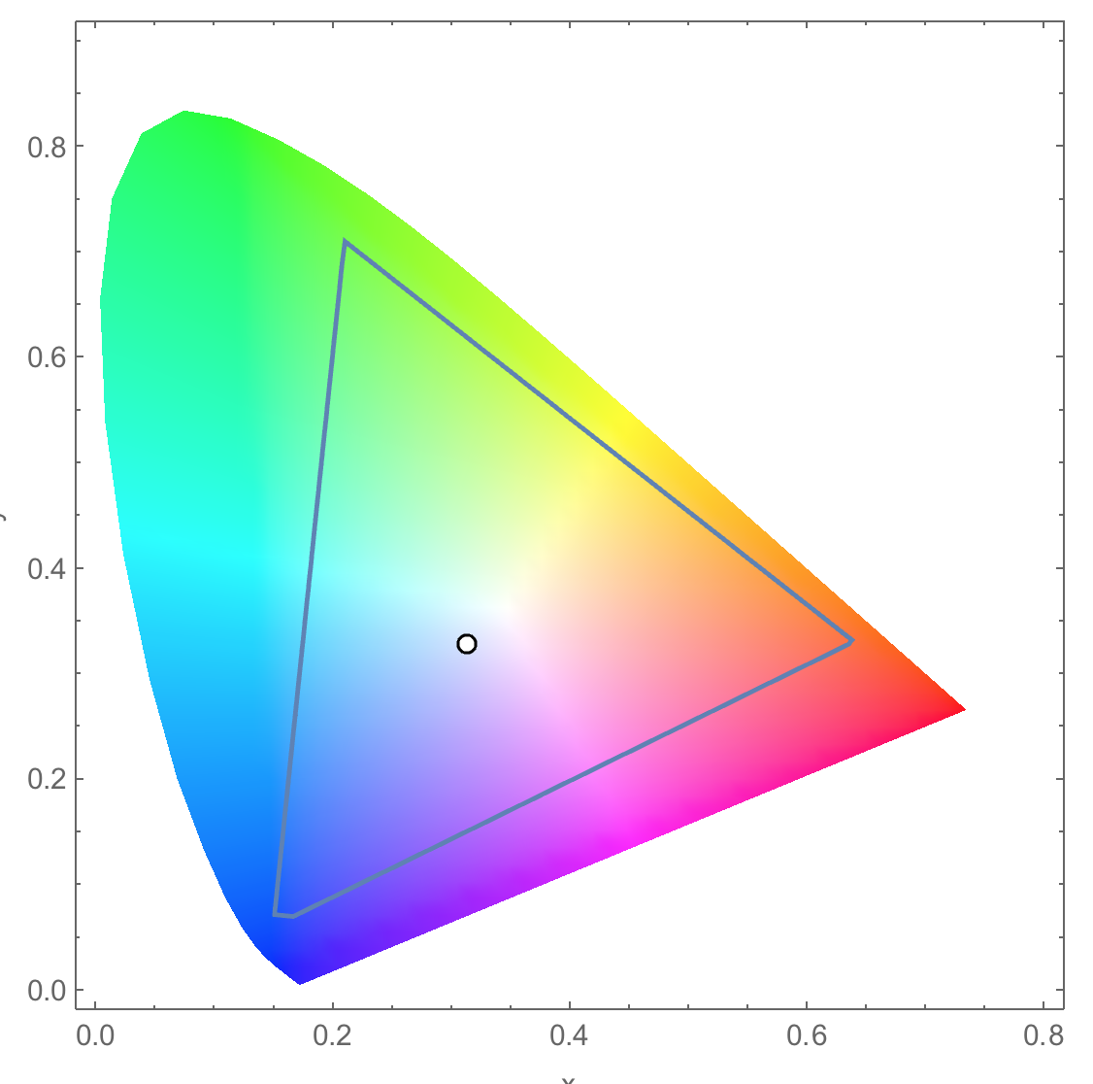
RGB Color Image Representation
Each pixel in an image is an RGB value
The format of an image’s row is (r g b) (r g b) … (r g b)
RGB ranges are not distributed uniformly
Many different color spaces, here we show the constants to convert to AdbobeRGB color space
The vertical axis (y value) and horizontal axis (x value) show the fraction of the pixel intensity that should be allocated to G and B. The remaining fraction (1-y–x) of the pixel intensity that should be assigned to R
The triangle contains all the representable colors in this color space

Slide 4


RGB to Grayscale Conversion
A grayscale digital image is an image in which the value of each pixel carries only intensity information.

Slide 5
Color Calculating Formula
For each pixel (r g b) at (I, J) do: grayPixel[I,J] = 0.21*r + 0.71*g + 0.07*b
This is just a dot product <[r,g,b],[0.21,0.71,0.07]> with the constants being specific to input RGB space
0.71
0.21
0.07

Slide 6
RGB to Grayscale Conversion Code
#define CHANNELS 3 // we have 3 channels corresponding to RGB
// The input image is encoded as unsigned characters [0, 255]
__global__ void colorConvert(unsigned char * grayImage,
unsigned char * rgbImage,
int width, int height) {
int x = threadIdx.x + blockIdx.x * blockDim.x;
int y = threadIdx.y + blockIdx.y * blockDim.y;
if (x < width && y < height) {
// get 1D coordinate for the grayscale image
int grayOffset = y*width + x;
// one can think of the RGB image having
// CHANNEL times columns than the gray scale image
int rgbOffset = grayOffset*CHANNELS;
unsigned char r = rgbImage[rgbOffset ]; // red value for pixel
unsigned char g = rgbImage[rgbOffset + 2]; // green value for pixel
unsigned char b = rgbImage[rgbOffset + 3]; // blue value for pixel
// perform the rescaling and store it
// We multiply by floating point constants
grayImage[grayOffset] = 0.21f*r + 0.71f*g + 0.07f*b;
}
}

Slide 7
RGB to Grayscale Conversion Code
#define CHANNELS 3 // we have 3 channels corresponding to RGB
// The input image is encoded as unsigned characters [0, 255]
__global__ void colorConvert(unsigned char * grayImage,
unsigned char * rgbImage,
int width, int height) {
int x = threadIdx.x + blockIdx.x * blockDim.x;
int y = threadIdx.y + blockIdx.y * blockDim.y;
if (x < width && y < height) {
// get 1D coordinate for the grayscale image
int grayOffset = y*width + x;
// one can think of the RGB image having
// CHANNEL times columns than the gray scale image
int rgbOffset = grayOffset*CHANNELS;
unsigned char r = rgbImage[rgbOffset ]; // red value for pixel
unsigned char g = rgbImage[rgbOffset + 1]; // green value for pixel
unsigned char b = rgbImage[rgbOffset + 2]; // blue value for pixel
// perform the rescaling and store it
// We multiply by floating point constants
grayImage[grayOffset] = 0.21f*r + 0.71f*g + 0.07f*b;
}
}

Slide 8
RGB to Grayscale Conversion Code
#define CHANNELS 3 // we have 3 channels corresponding to RGB
// The input image is encoded as unsigned characters [0, 255]
__global__ void colorConvert(unsigned char * grayImage,
unsigned char * rgbImage,
int width, int height) {
int x = threadIdx.x + blockIdx.x * blockDim.x;
int y = threadIdx.y + blockIdx.y * blockDim.y;
if (x < width && y < height) {
// get 1D coordinate for the grayscale image
int grayOffset = y*width + x;
// one can think of the RGB image having
// CHANNEL times columns than the gray scale image
int rgbOffset = grayOffset*CHANNELS;
unsigned char r = rgbImage[rgbOffset ]; // red value for pixel
unsigned char g = rgbImage[rgbOffset + 2]; // green value for pixel
unsigned char b = rgbImage[rgbOffset + 3]; // blue value for pixel
// perform the rescaling and store it
// We multiply by floating point constants
grayImage[grayOffset] = 0.21f*r + 0.71f*g + 0.07f*b;
}
}

Slide 9
The GPU Teaching Kit is licensed by NVIDIA and the University of Illinois under the Creative Commons Attribution-NonCommercial 4.0 International License.

